Slide 1

A Introduction to Law

Slide 2
The Brief History of Law
Every culture has had Laws and religion
Trial by Ordeal
Roman Law
Kings law
Trial by Jury
Common Law
Civil law

Slide 3
What is the Law
It gives you a route to seek remedy
It protects you by giving your rights
The Rules for Life
Not all would be deemed a fair by todays standards

Slide 4
English Common Law

Slide 5
What is English Common Law
It is all about Fairness
Honour
How we interact
The rules for agreement
The rules for trade
When someone claims to have been wronged
It provides a method of Remedy
Is practised in every British colony they established

Slide 6
King Billy and old olie crum
The Kings right's
The civil war
The fundament change-everyone equal under the law.
No one has jurisdiction over another without consent
You have the same rights as the monarch
The Magna Carta Article 39 and 40 ratified in the bill of rights
the bill of rights is valid today
It gives us the right to seek remedy by jury

Slide 7
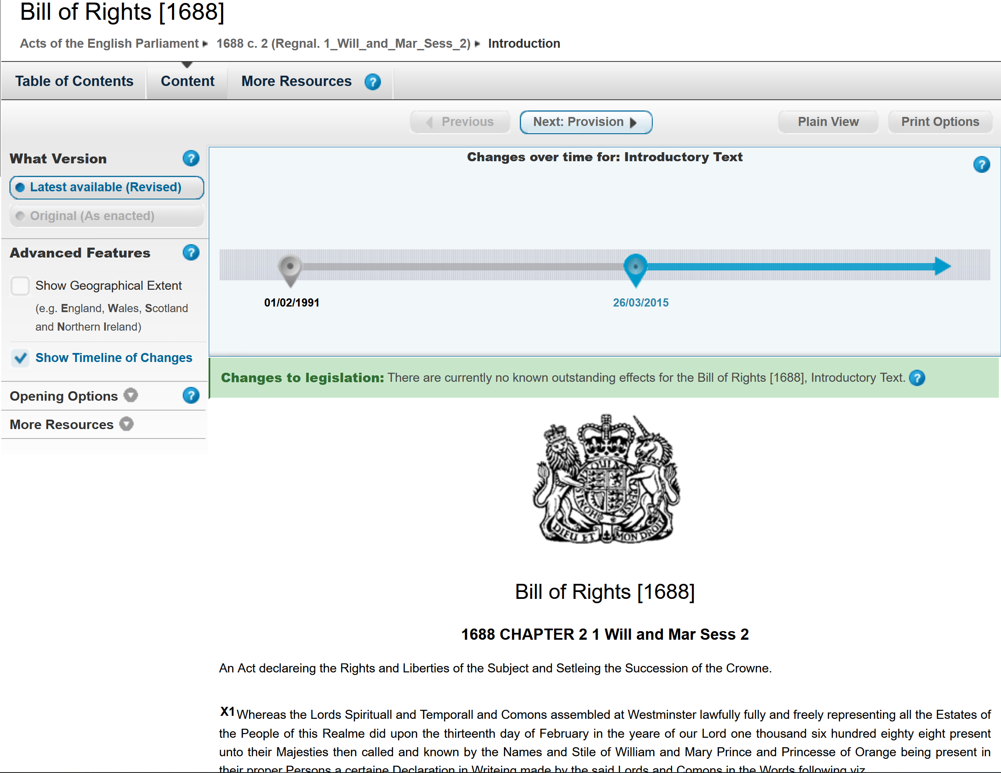
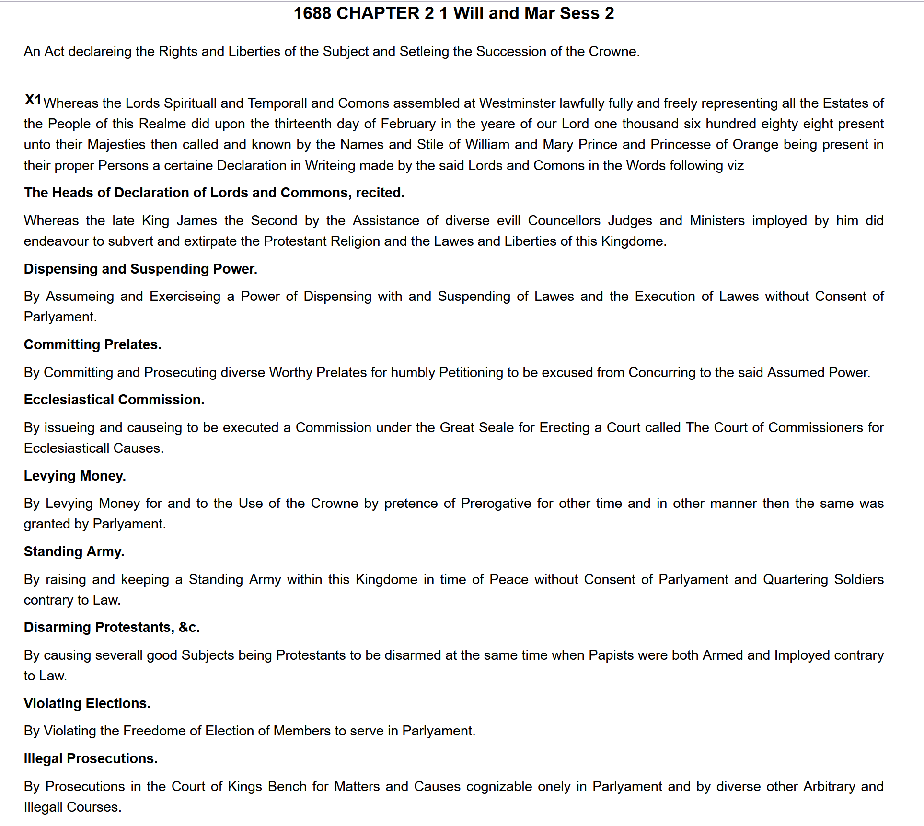
English Common Law
https://www.legislation.gov.uk/aep/WillandMarSess2/1/2/introduction
Magna Carter – bill of rights article 61 Lords and barons ( all free men) Same rights as the king.
It is about honour and integrity
The jury System
The principles of law
The court system.
The history of precedence

Slide 8
Your Rights
You are free to do as you choose, as long as you obey three little rules.
Cause no harm or by action cause harm
Cause no loss or by action cause loss
Honour thy agreements
You accept total responsibility and liability for your actions.

Slide 9
Your Rights as the Accused
You must have an individual claiming you have cause injury or loss that files a complainant
You have the right to know the nature and the charges
The right to be fully informed of how all liabilities and obligations have been created
The right to responsive answers you may have about the nature of the charges
The Right to face your accuser

Slide 10
Your Rights as the Accused
Intent and un-intentional act
The burden of proof is on the accuser
Trial by debate backed by evidence
What is evidence Physical, documentation, expert witness, person with first hand knowledge.
A presumption stands until rebutted
Maximus The Un-rebuttable argument
The affidavit – fact in law till rebutted - Perjury
Four outcomes Guilty, Not Guilty, No Contest, Nullification.

Slide 11
Seeking Remedy
Acquire Standing in a Court of Law
A Cause of Action
Elements of a cause of action
Harm
Loss
Breach of agreement
Tort
Jurisdiction

Slide 12
Jurisdiction
Jurisdiction is everything (To risk life, to impose any rules, to have rights)
Laws and rules are only enforceable if you have jurisdiction
There is no human rights in Common Law.
Breach of jurisdiction.
Court represents your jurisdiction – Where you seek remedy

Slide 13
Elements of Your Jurisdiction
Over your body
Over your Property
Under agreement

Slide 14
The Common Law Court
A court exercises Yours Jurisdiction as a plaintiff (accuser)
You file a complaint (affidavit) Cause of action in common law
Common law has a Jury of twelve
A court jurisdiction is Territorial and subject matter
The Judge personal and court (Must swear an oath).
Proceedings are bound by maximums and precedents
Common Law always the superior law
The Common Law Court system is free to use.

Slide 15
The Common Law Proceedings
The Judge administers the trial
Clark of the court. Handles all details of the trial.
Stenographer takes notes on the trail or records everything said.
The Plaintiff (the accuser) Can be represent by themselves, a Barrister or the PPS)
The Defendant Can be represent by themselves, or a Barrister

Slide 16
The Common Law Proceedings
The Trial
It is a debate based on evidence
Evidence Physical, documentation, expert witness, person with first hand knowledge.(No hearsay)
Its all about words, you do it on paper, just like a contract
Its about attitude
All evidence from the plaintiff must be given to the defendant before trial.

Slide 17
Court Rulings
Every case sets a precedent
The judge makes a summary of the precedent
The summary makes this a common law summary offence
Common Law is the superior law

Slide 18
Civil Law

Slide 19
Civil Law System
Developed from Admiralty Law and Roman Law
Commercial Law how we trade
Government law Statutes and acts and orders
Regulations for all services provided by government
Trading in commerce The birth certificate, capital dumsia the cooperation
The Person - A corp org club have equal rights as the individual under common and civil law.
The civil court no jury just a judge or judges
Judge makes the decision on balance of evidence Probability
Still must for fill the requirements for a cause of action
You must pay to access the civil court system.

Slide 20
The Cooperation
Any Company or organisation that registers becomes a person
The person is the one liable for their actions (limited Liability)
The Person has the same rights as an individual
The Person has access to both court systems
A Person is represented by capital letters

Slide 21
Its ALL ABOUT THE CONTRACT
The Contract
A contract is any financial Transaction or agreement (Contract)
An Contract is an agreement between one or more parties written on paper and signed by the parties as an individual or Representative of an organisation
You can agree to nearly anything,
Tentative agreement
A transaction without formal agreement
Buying and selling
As no agreement was formalized the default is government legislation

Slide 22
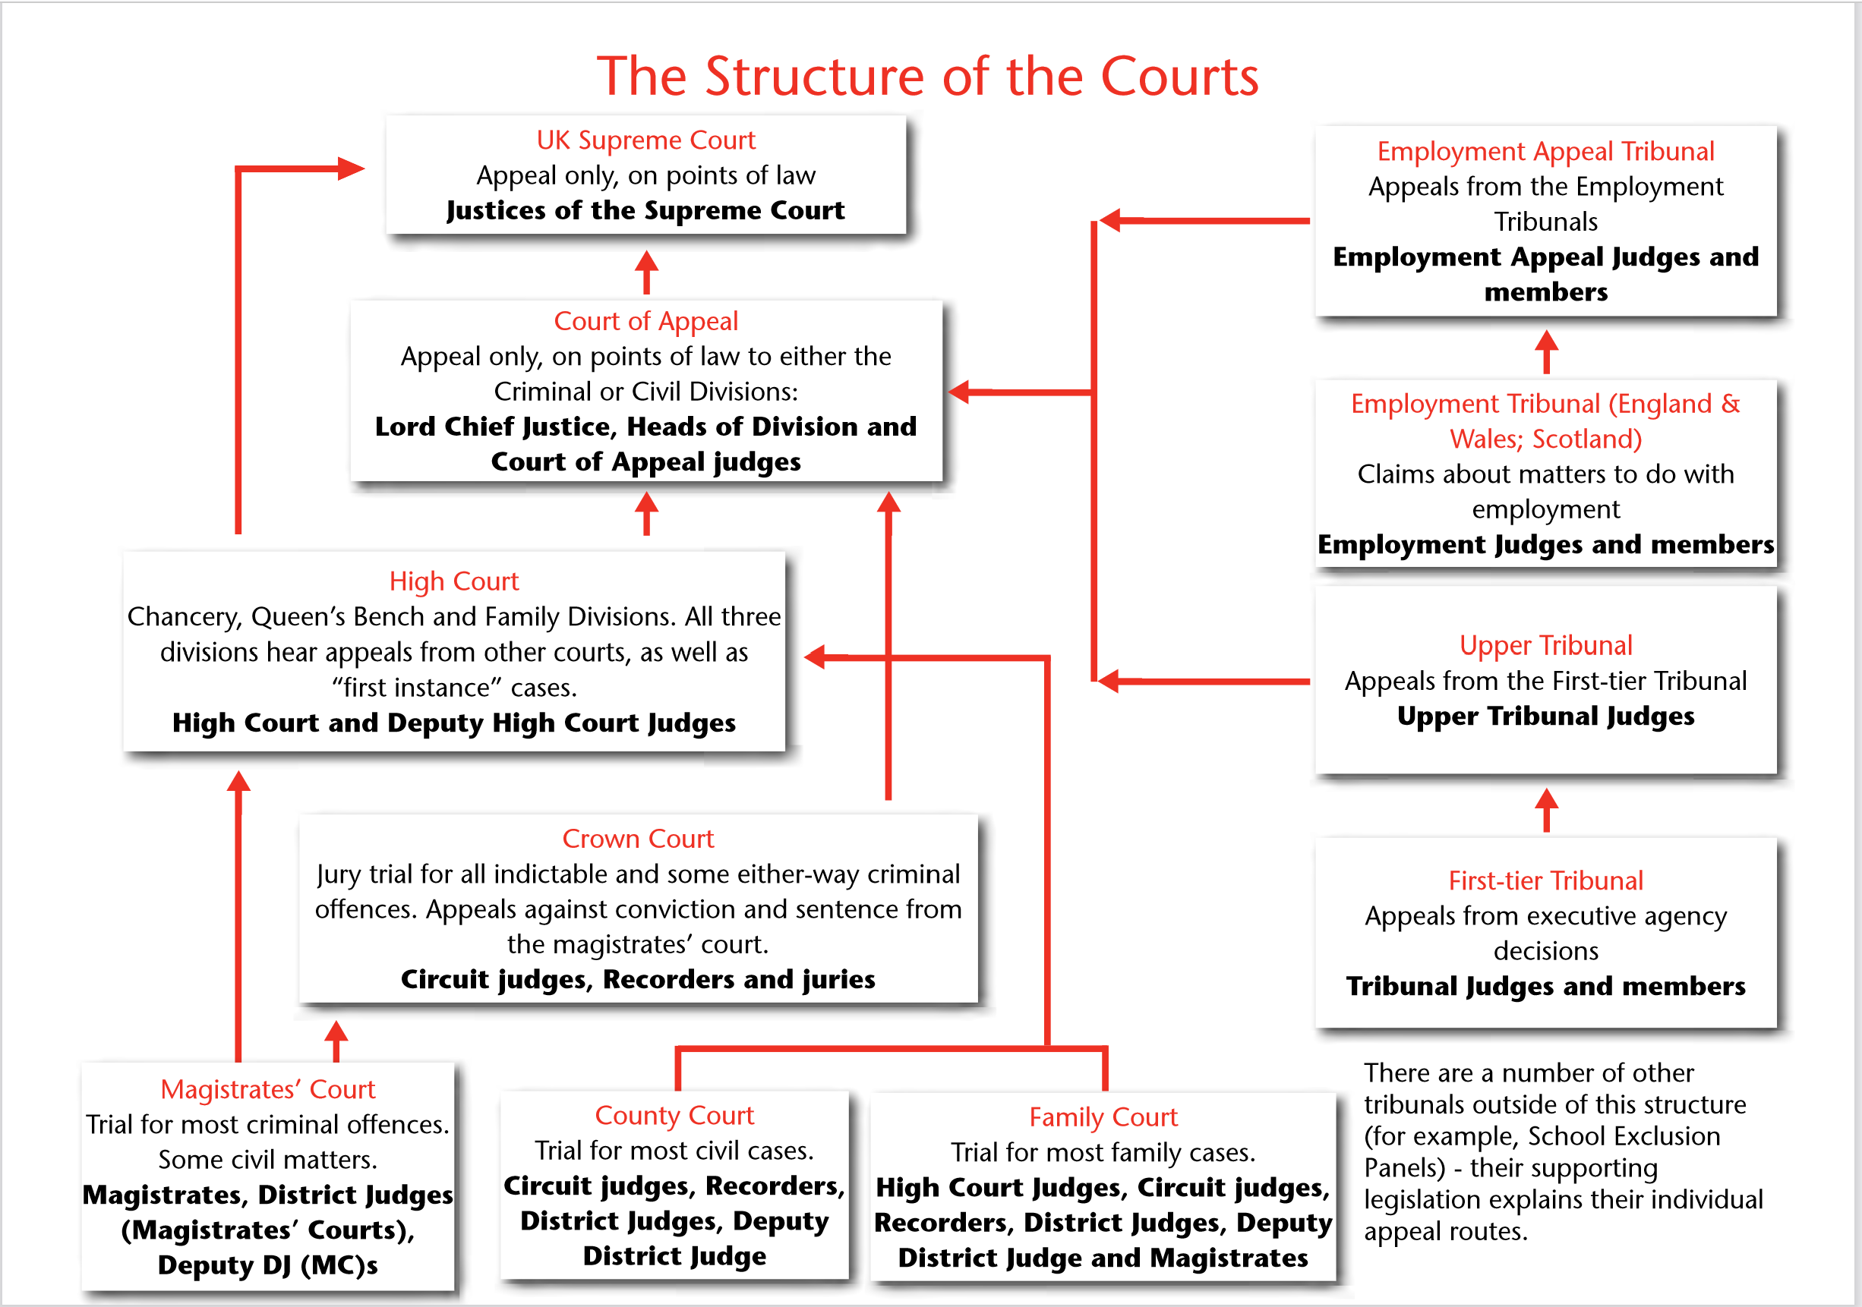
Official Court Structure

Slide 23
The Courts in Order
Magistrates Court (Civil Court)
County Court (Civil Court)
The Supreme Court (highest civil Court)
Crown Court
High Court
Court of Appeal
The House of Lords

Slide 24
Points to remember
Jurisdiction Is everything
For an action to be filed you must have an accuser
That accuser can be an individual or PERSON
They Must claim that you have caused harm, loss, breach of contract or a tort
They must have jurisdiction over the element in question
Jurisdiction can only be achieved if it is ones body, property or by agreement.
You are a freeman or woman because no one has jurisdiction over you over your property or agreements
In commerce the default is government legislation.
You accept total responsibility and liability for your actions.

Slide 25
Your Services

Slide 26
Police Service of Northern Ireland
The PSNI is a corporation
An PSNI Officer is a member of a corporation.
A Constable is a civilian under oath.
The police can only act against you as a constable
You must have caused or directly threaten harm, loss, caused a tort (breach of the peace)
They are a service to you if you have been wronged
Police researches your complaint
Gather evidence and hand all evidence to the Public Prosecution Services

Slide 27
Public Prosecution Service
The PPS compile a case and present to court
Free to use
You don’t have to use their services

Slide 28
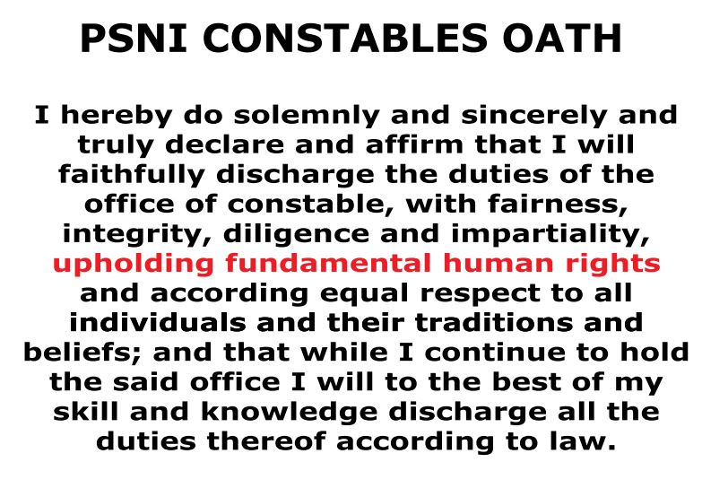
Police Constable Oath

Slide 29
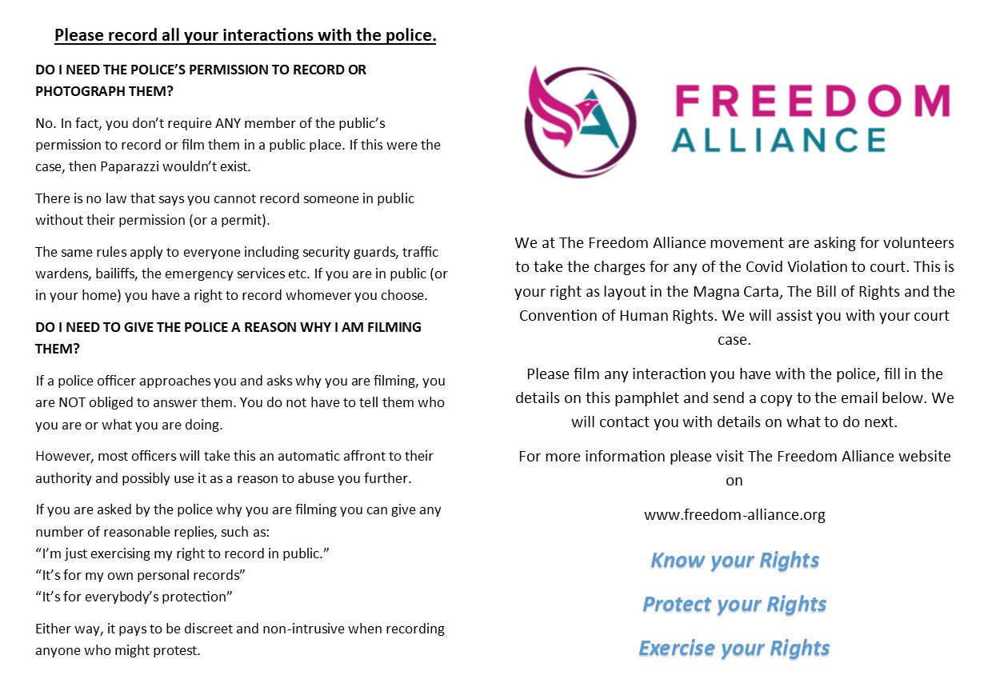
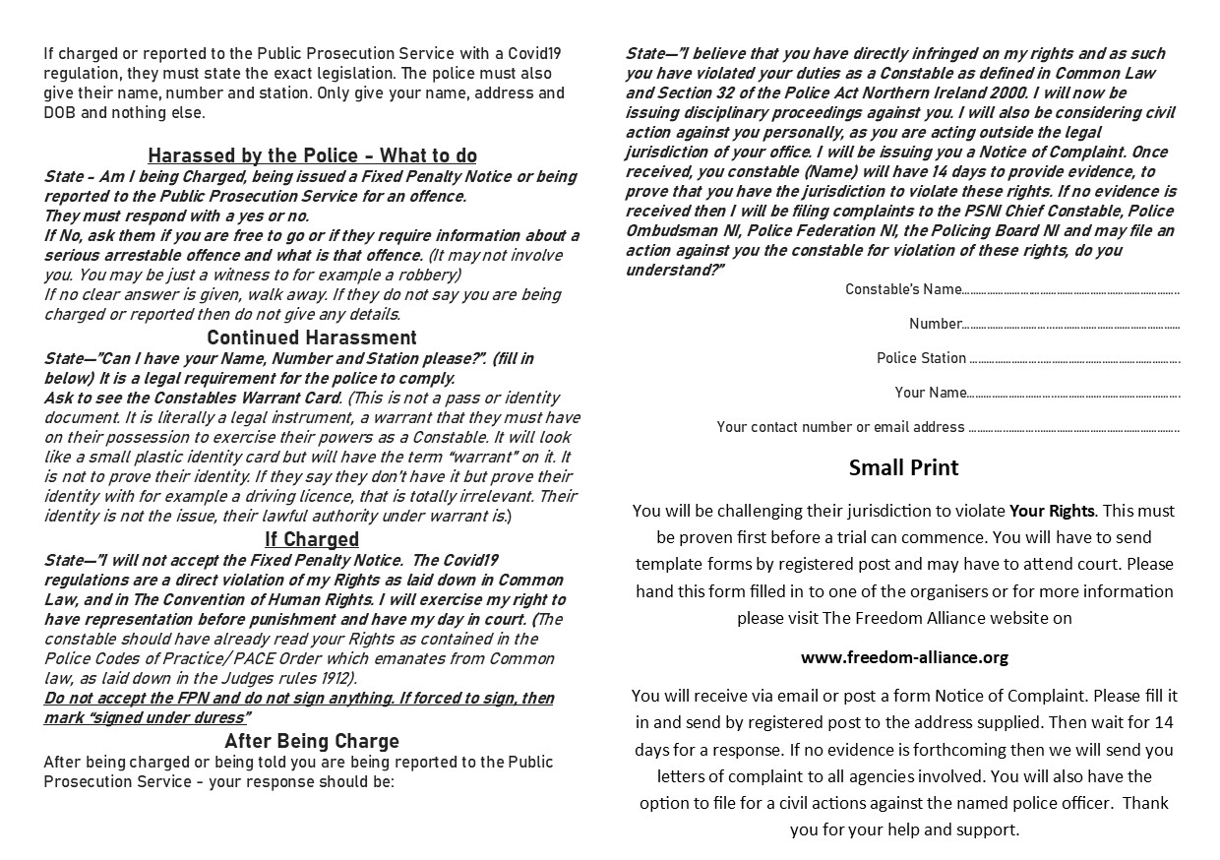
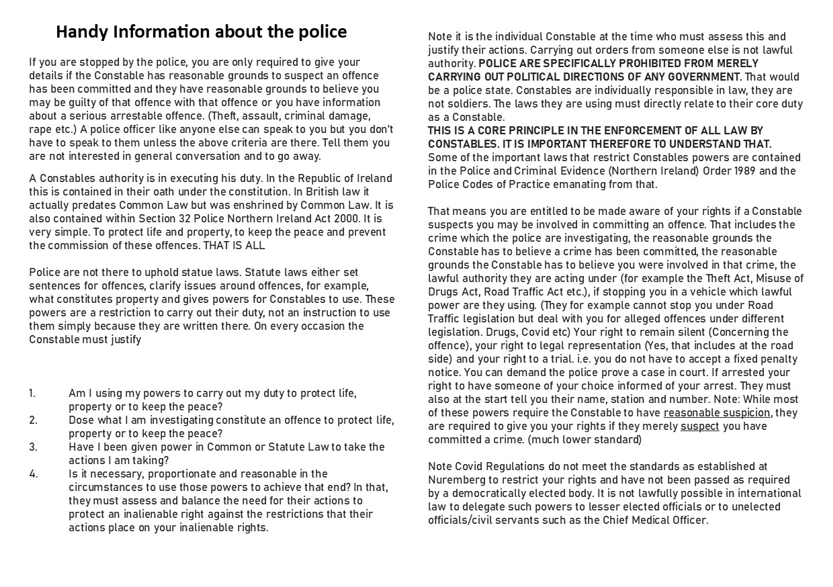
How to interact with the police

Slide 30
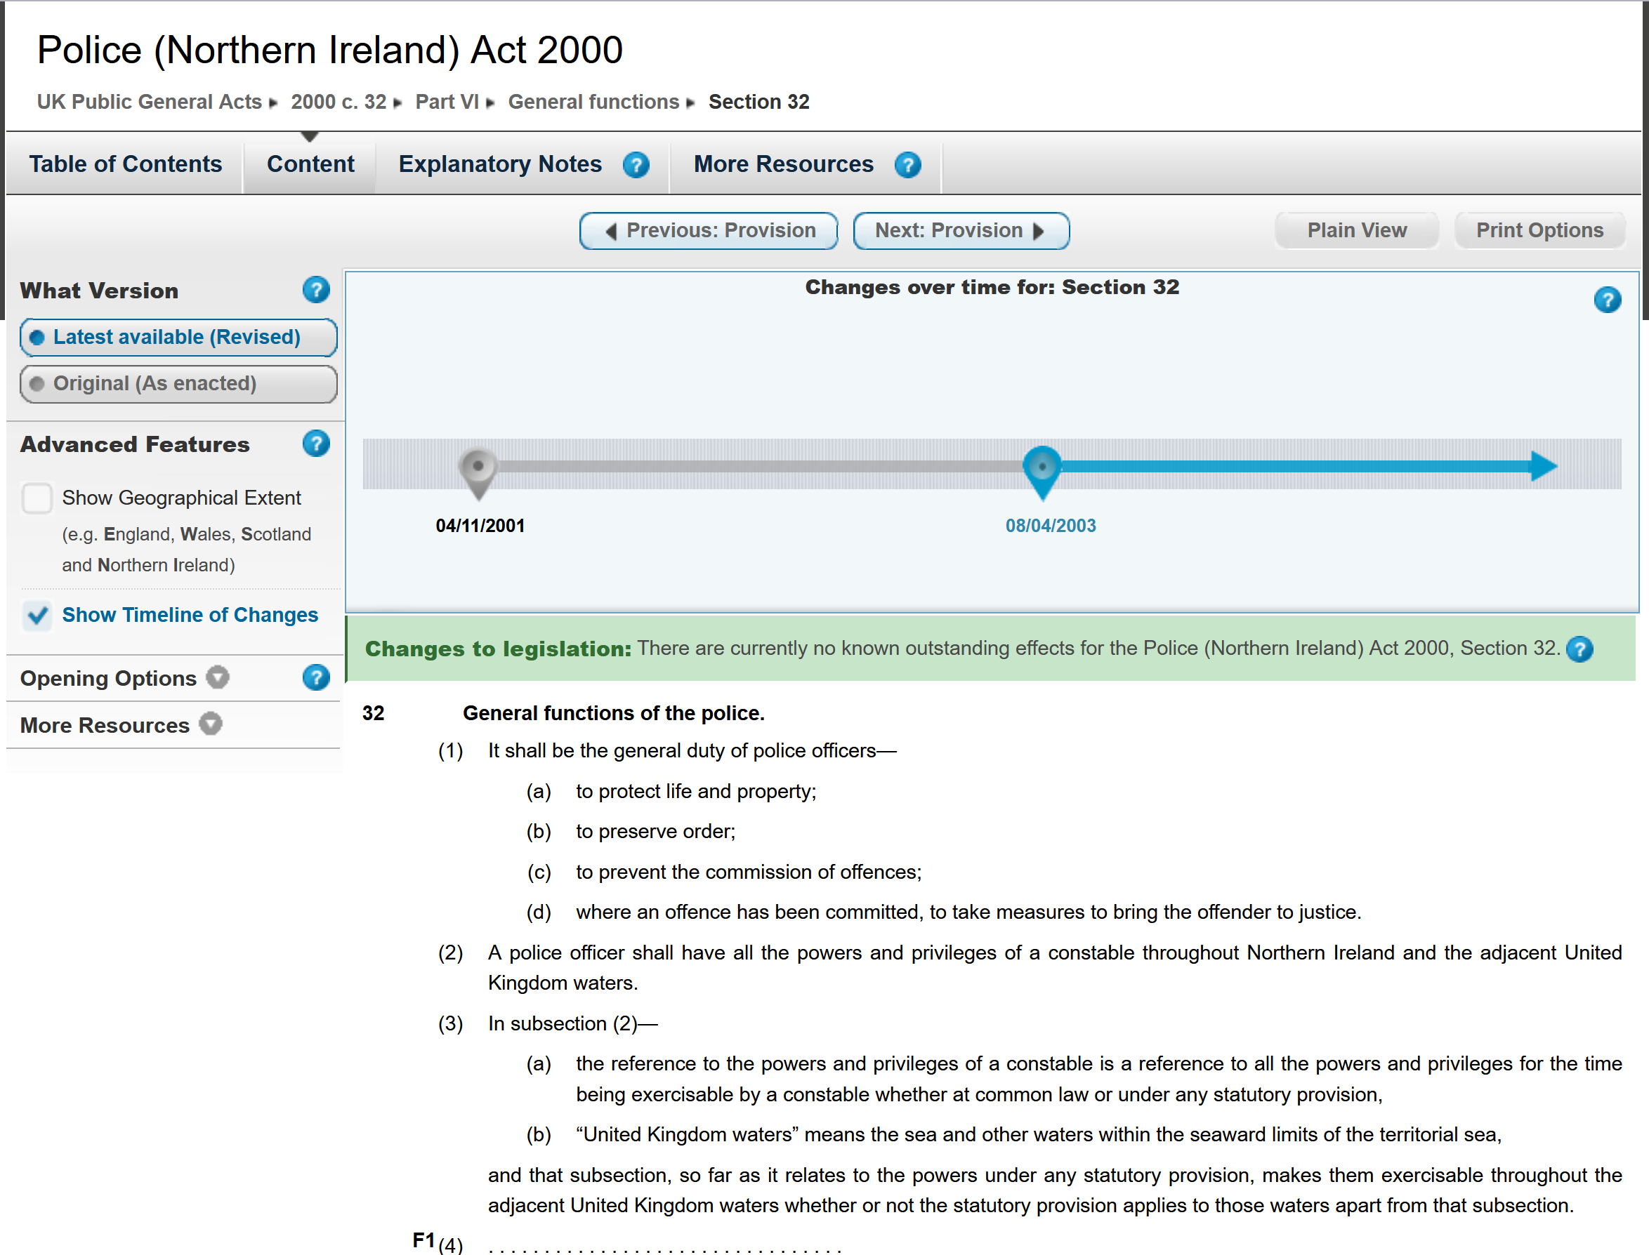
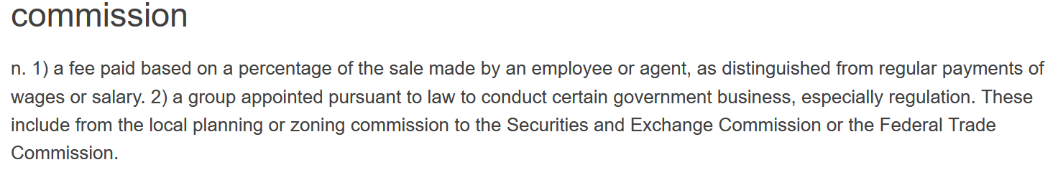

Slide 31
Understanding of the Law Today
No one know the Rules of the games
Presumed consent
The play on words legalise
Not even courts at best tribunals
Solicitor - hands of your rights to the court.
Rules for commercial benefit very little evidence provide during filing.
Conditioning for commercial fraud (the on the spot fine)
Commercial interests making the laws - Lobbyists
The Law society and government relation with judges
The cost of the system

Slide 32
Evil Triumphs when good people stand and do nothing
Covid Regulations - Exercise your right and take all charges to court
Vaccine - Forced medical treatment has plenty of precedents against it It is still in trail phase
Hold those imposing the rules liable
Put in writing a notice of acceptance of liability to anyone imposing vaccination mask social distancing etc.
If they don’t Accept liability quote the discrimination laws and charge them. If they do agree decline their offer.
Go after business, venues and government services
Civil disobedience Don’t follow any rules that violate your rights and jurisdiction
We must be prepared to go to court and stand and defend yourselves.

Slide 33
The evidence for Jurisdiction

Slide 34
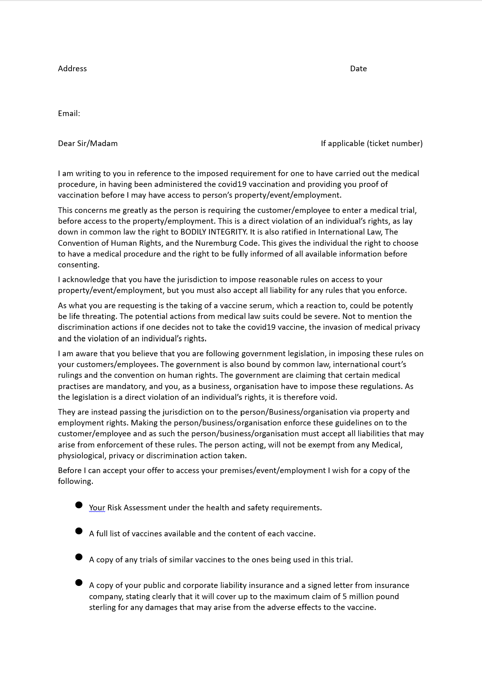
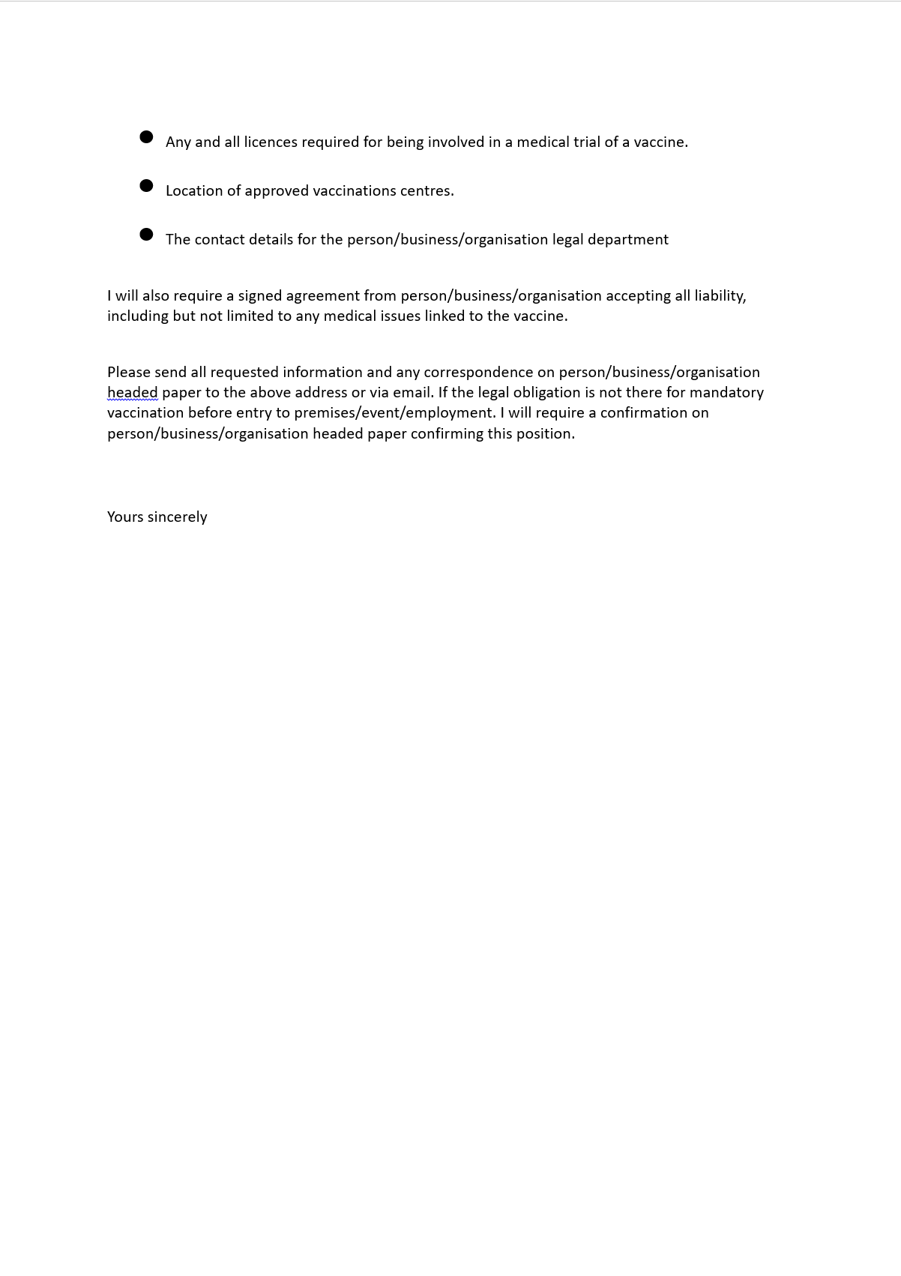
Hold them to account

Slide 35

Contact details
Website – freedomallianceioi.com
Email – info@freedomallianceioi.com
Tel: - 02877729720
Usefull Links
Government Website https://www.legislation.gov.uk/
https://www.justice.gov.uk/courts/procedure-rules/civil/rules/part11
https://www.judiciaryni.uk/
Lectures and Talks Bill Thornton Common Law - www.1215.org
Marc Stevens No State Project
John Harris

