Slide 1

How to fight back

Slide 2
Jurisdiction
Jurisdiction is everything (To risk life, to impose any rules, to have rights)
Laws and rules are only enforceable if you have jurisdiction
There is no human rights in Common Law.
Breach of jurisdiction.
Court represents your jurisdiction – Where you seek remedy

Slide 3
Elements of Jurisdiction
Over your body
Over your Property
Under agreement

Slide 4
The Cooperation
Any Company or organisation that registers becomes a person
The person is the one liable for their actions (limited Liability)
The Person has the same rights as an individual
The Person has access to both court systems
A Person is represented by capital letters

Slide 5
Its ALL ABOUT THE CONTRACT
The Contract
A contract is any financial Transaction or agreement (Contract)
An Contract is an agreement between one or more parties written on paper and signed by the parties as an individual or Representative of an organisation
You can agree to nearly anything,
Tentative agreement
A transaction without formal agreement
Buying and selling
As no agreement was formalized the default is government legislation

Slide 6
Liability
You can only enforce a regulation if you have jurisdiction
If you have jurisdiction you can write any law you wish
Business have jurisdiction over Property and under contract
You accept total responsibility and liability for any rules you impose

Slide 7
Evil Triumphs when good people stand and do nothing
Covid Regulations - Exercise your right and take all charges to court
Vaccine - Forced medical treatment has plenty of precedents against it It is still in trail phase
Hold those imposing the rules liable
Put in writing a notice of acceptance of liability to anyone imposing vaccination mask social distancing etc.
If they don’t Accept liability quote the discrimination laws and charge them. If they do agree decline their offer.
Go after business, venues and government services
Civil disobedience Don’t follow any rules that violate your rights and jurisdiction
We must be prepared to go to court and stand and defend yourselves.

Slide 8
Dealing with the police

Slide 9
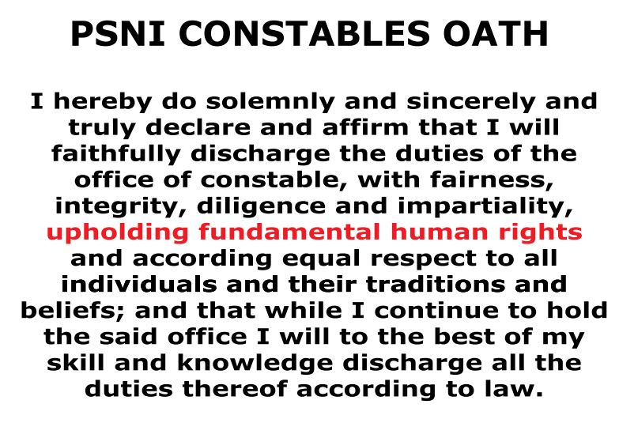
Police Constable Oath

Slide 10
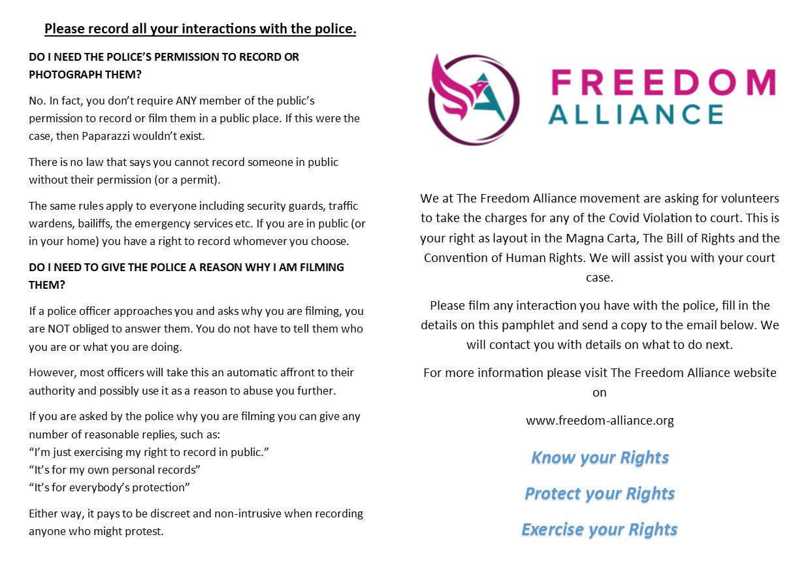
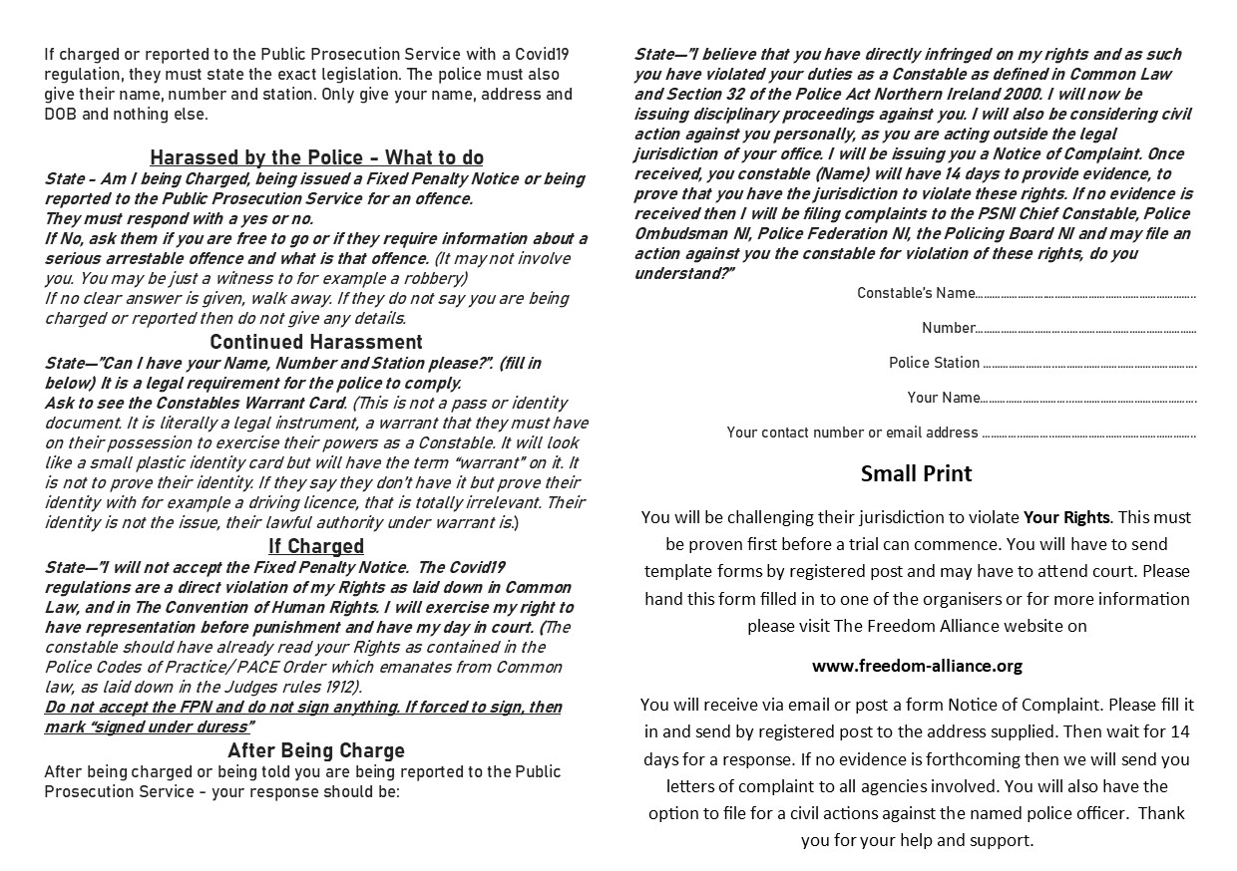
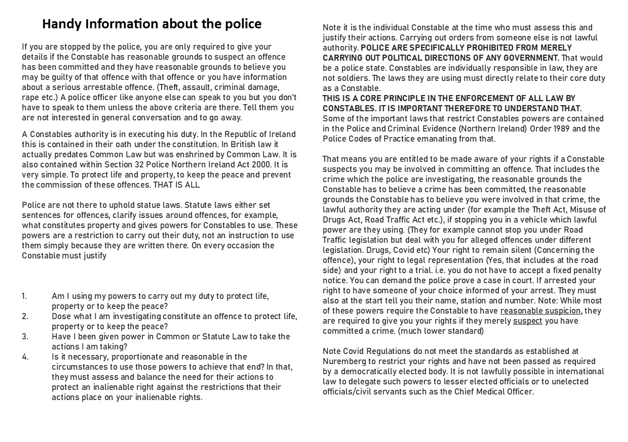
How to interact with the police

Slide 11
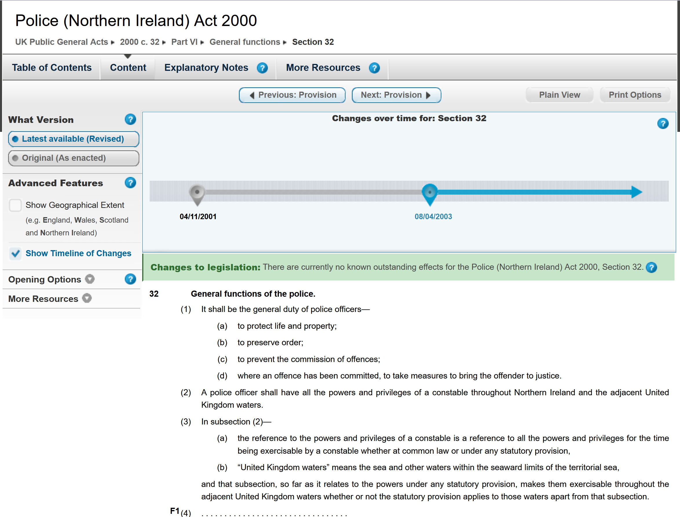
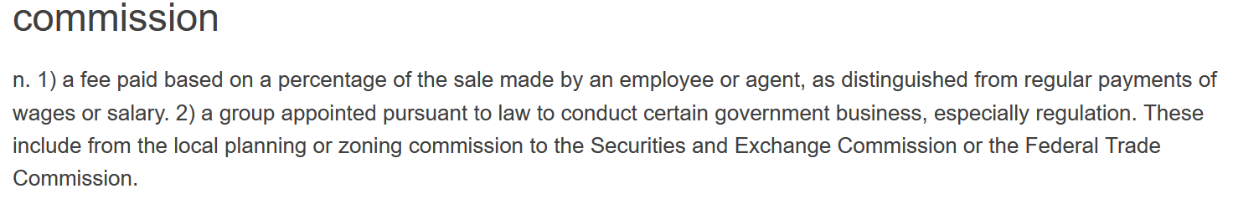

Slide 12
The evidence for Jurisdiction

Slide 13
Businesses imposing redtrictions
Hold them to account
Ask for their Risk Assessment, Licences, insurance
Research the actual legislation
Target a individual rather than the organisation
Write to them about your concerns
Get confirmation they are being held liable

Slide 14
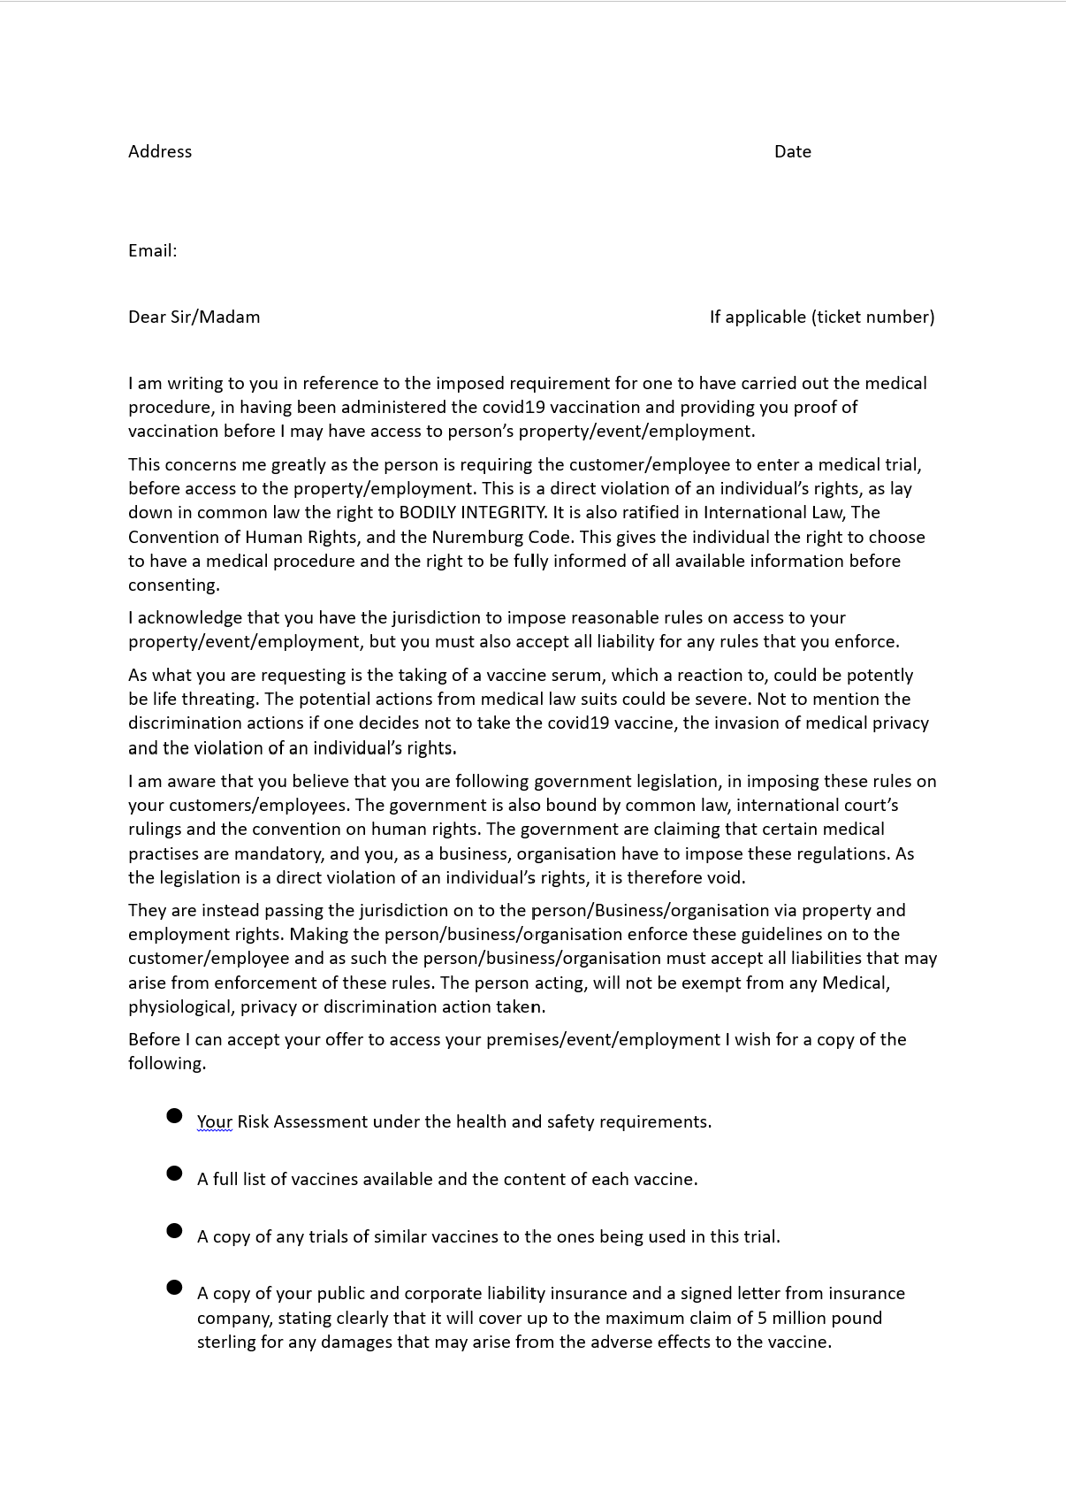
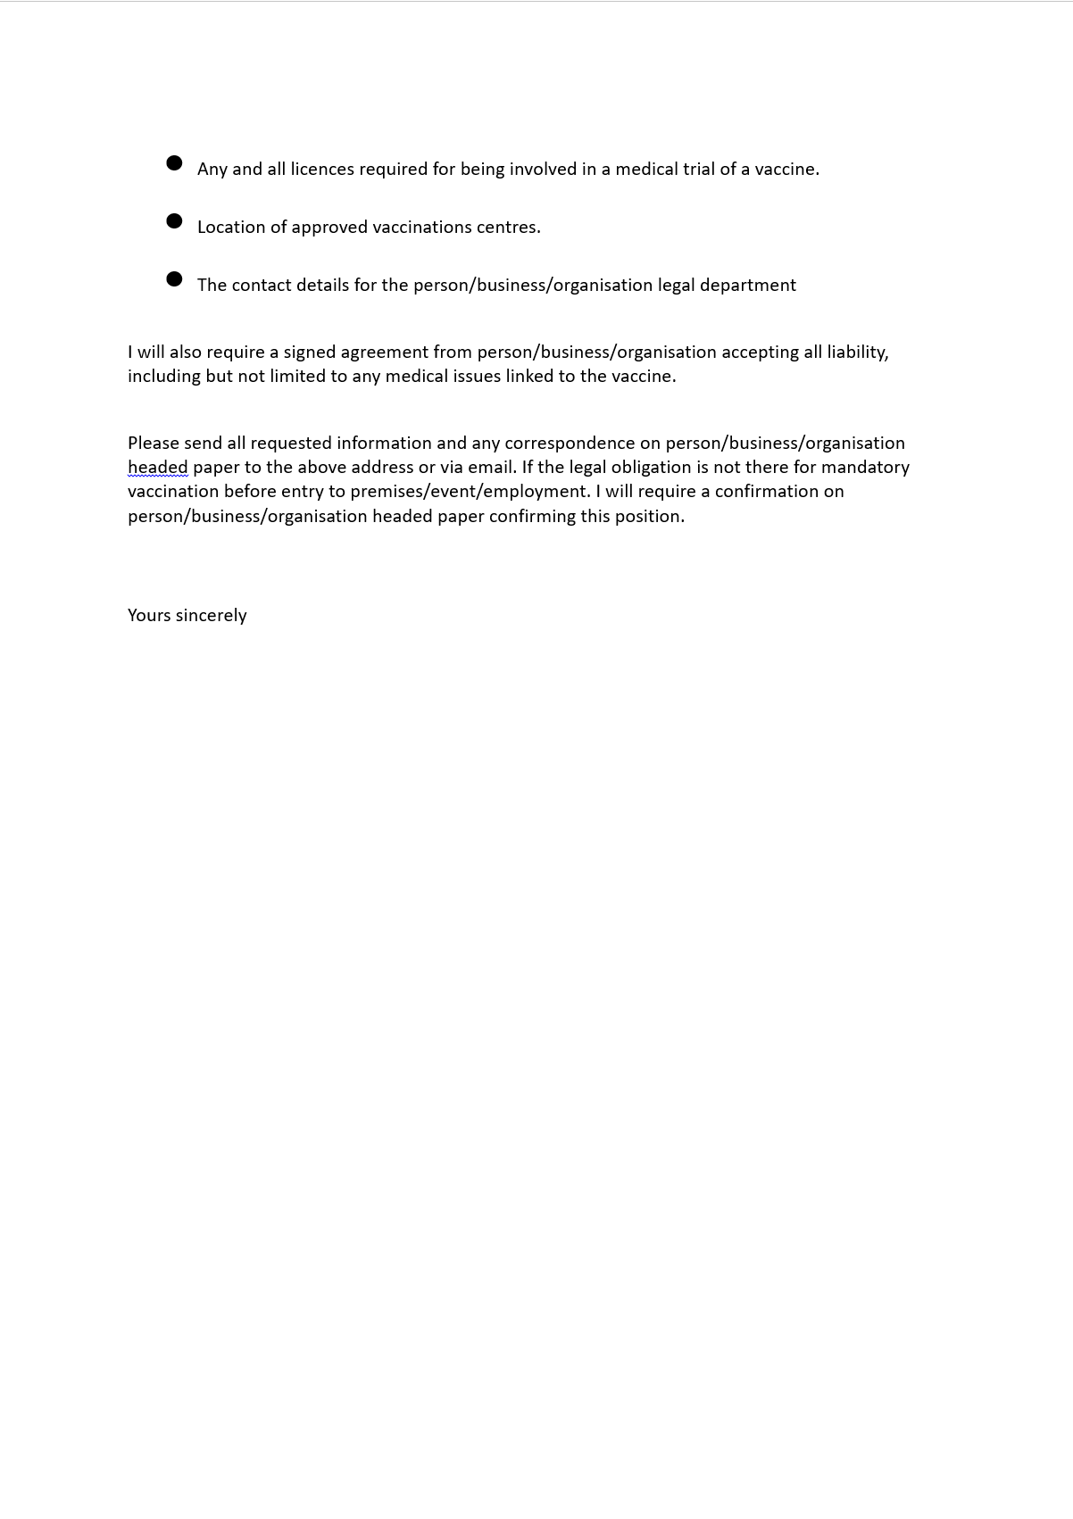
Hold them to account

Slide 15

Contact details
Website – freedomallianceioi.com
Email – info@freedomallianceioi.com
Tel: - 02877729720
Usefull Links
Government Website https://www.legislation.gov.uk/
https://www.justice.gov.uk/courts/procedure-rules/civil/rules/part11
https://www.judiciaryni.uk/
Lectures and Talks Bill Thornton Common Law - www.1215.org
Marc Stevens No State Project
John Harris

